Slide 1
2023 Year 10
Subject Selection for Stage 6
For Year 10 students and their parents/caregivers

Slide 2
Acknowledgement of Country
I acknowledge the Traditional Custodians of Country on which we meet today. I acknowledge the Aboriginal and Torres Strait Islander peoples' connections to land, sea and community. I pay my respect to their elders past and present and extend that respect to all First Nations peoples present with us today.

Slide 3
Course Selection Considerations

Slide 4
Course Selection Considerations
Abilities, Interests and Motivation
Career aspirations and prerequisites
Syllabus requirements - Practical/Major work components
Subject combinations
Other commitments eg sport, community involvement
Notes:
Abilities - choose subjects that you know you are capable of doing well. Discuss this with your teachers and seek advice on the level of course you should select, for example, English Advanced or English Standard
Interests/Motivation- choose subjects that interest you.
Career aspirations and needs - keep in mind future career paths but be realistic about choices.
Syllabus Requirements – be mindful of how many practical works are required for your pattern of study and the timing of submission.
Subject combinations - do the subjects complement each other?
Other commitments - when choosing subjects, it its important to balance study with outside commitments and influences such as work, sport and family.
https://www.educationstandards.nsw.edu.au/wps/portal/nesa/11-12/hsc/subject-selection

Slide 5
Higher School Certificate

Slide 6
Higher School Certificate (HSC)
is the highest educational award that can be achieved at secondary school in NSW
reports student achievement in terms of a standard achieved in individual courses
presents a profile of student achievement across a broad range of subjects
Notes:
https://www.educationstandards.nsw.edu.au/wps/portal/nesa/11-12/hsc/subject-selection

Slide 7
HSC Course Structure
All courses in the HSC have a unit value
Most courses are 2 units which equates to 120 hours of study and a HSC result out of 100
  Some courses are 1 unit. This is equivalent to 60 hours of study and a HSC result out of 50
Many 1 unit courses are extension courses eg English Extension 1, History Extension 1, Maths Extension 2 or Science Extension.
Notes:
https://www.educationstandards.nsw.edu.au/wps/portal/nesa/11-12/hsc/subject-selection
https://ace.nesa.nsw.edu.au/ace-8064

Slide 8
Requirements for the HSC
Year 11
minimum of 12 units
students must satisfactorily complete the Year 11 course before commencing the corresponding Year 12 course
Year 12
minimum of 10 units
Notes:
Students may accumulate course units towards the HSC for a period of up to 5 years.
Students may choose to undertake this ‘pathway’ approach for a variety of reasons including:
commitments outside school - part time work, elite sportsperson etc.
apprenticeship or traineeship
acceleration
repeating
http://educationstandards.nsw.edu.au/wps/portal/nesa/11-12/hsc/subject-selection
https://ace.nesa.nsw.edu.au/ace-8036

Slide 9
Requirements for the HSC
Both the Year 11 and Year 12 pattern of study must include:
2 units of compulsory English
at least 6 units of Board Developed Courses
at least 3 courses of 2 units value or greater
at least 4 subjects (including English)
a maximum of 6 units of Science may be included in the Year 11 pattern of study
Notes:
English is mandatory for the HSC.
English Studies and Mathematics Standard 1 are Board Developed Courses with an optional HSC examination. Students who choose English Studies and/or Mathematics Standard 1, but wish to receive an ATAR, must undertake the optional examination.
Extension courses are not separate subjects. E.g. Advanced English (2 units) + Extension 1 (1 unit) + Extension 2 (1 unit) = 4 units but only 1 subject.
At most, 6 units of courses in Science can be included in the pattern of study for Year 11. However, in Year 12, this increases to 7 units of Science, to allow for the study of Science Extension.
https://ace.nesa.nsw.edu.au/ace-8005

Slide 10
Satisfactory completion of a Course
The Higher School Certificate – A Snapshot
Students must:
follow the course developed or endorsed by NESA
apply themselves with diligence and sustained effort to the set task and experiences provided in the course by the school; and
achieve some or all of the course outcomes
VET Board Developed Courses require students to complete mandatory work placement eg 70 hours over Year 11 and 12.
Notes:
https://www.educationstandards.nsw.edu.au/wps/portal/nesa/11-12/hsc/rules-and-processes
https://ace.nesa.nsw.edu.au/ace-8019

Slide 11
Additional completion requirements for HSC courses
Students must:
complete HSC assessment tasks that contribute in excess of 50 per cent of available marks in courses where internal assessment marks are submitted
                and
sit for and make a serious attempt at any requisite Higher School Certificate examinations for a course
Notes:
https://ace.nesa.nsw.edu.au/ace-8020
https://ace.nesa.nsw.edu.au/ace-8026
http://educationstandards.nsw.edu.au/wps/portal/nesa/11-12/hsc/rules-and-processes

Slide 12
Making the selection

Slide 13
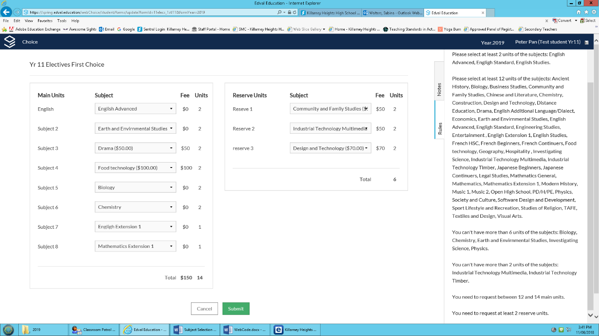
The process – first choice
1. An email is sent to the DET email address from Killarney Heights High
2. Copy the code first eg MEWM9
3. Follow the link
4. Select at least 12 units (each course is 2 units) from The Main Units column and at least 3 from the Reserve units’ column
5. Select submit
The selection may be changed at any time until the close date
These choices are used to construct the lines

Slide 14
Accessing the Subject Selection Email
Yr 11 First Choice
Killarney Heights High School <edval-noreply@tes.com>
STEP 1: Click: my.edval.education/login
STEP 2: Enter the following WebCode: QQCW2
STEP 3: Select at least 12 units from The Main Units column and at least 3 from the Reserve units column
STEP 4: Click [Submit].
STEP 5: The summary does not need to be signed, as this information is being used to construct the options that will be available.
STEP 6: You may change your selection at any time up until Thursday 21st 3:10 pm

Slide 15
How Lines work
Line 1 | Line 2 | Line 3 | Line 4 | Line 5 | Line 6 | Line 7 | Line 8
Mathematics Advanced Mathematics Standard 2 | English Advanced English Standard EALD English | Chemistry Engineering Studies Geography Investigating Science Legal Studies Music 1 PD/H/PE Visual Arts | Biology Business Studies Legal Studies Society and Culture Software Design and Development Textiles and Design | Ancient History Business Studies Chemistry Drama Food Technology Modern History PD/H/PE Physics | Biology Community and Family Studies Economics Investigating Science Industrial Technology-Multimedia Physics Sports Lifestyle and Recreation Visual Arts | Mathematics Extension 1 Hospitality | English Extension 1

Slide 16
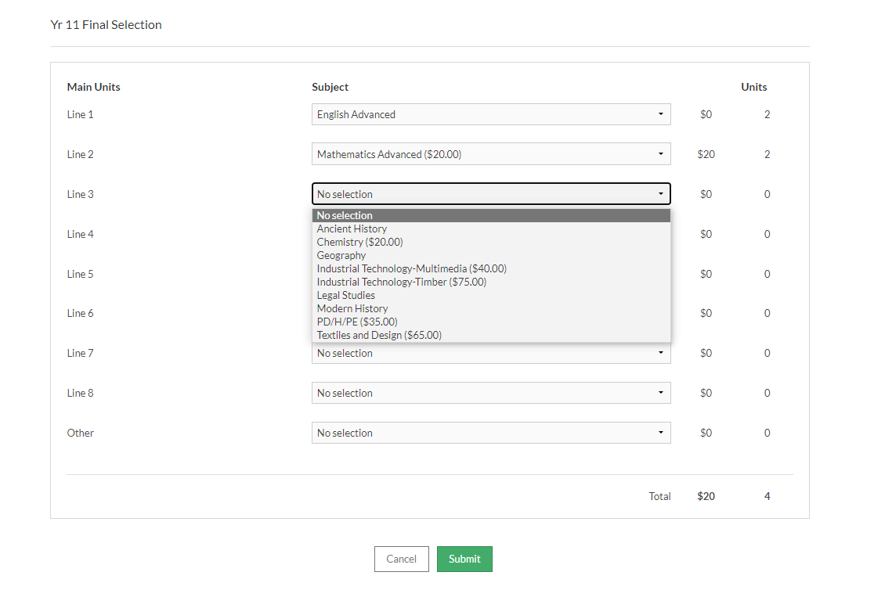
The process – formal choice
1. A new email is sent to the DET email address from Killarney Heights High
Copy the code first eg MEWM9
Follow the link
Select 1 option from each line
Select a minimum of 12 units
If choosing from the “other “ category 14 units must be selected
Select submit
The selection may be changed at any time until the close date

Slide 17
Timeline
Year 11 First Choice open | Wednesday Week 8 | 14 June
Year 11 First Choice close | Wednesday Week 9 | 21 June
Lines created | Week 10/Holidays
Year 11 Lines open to students | Friday Week 1 | 21 July
Year 11 Lines close for students | Friday Week 2 | 28 July
Parent and student interviews | Wednesday Week 4 | 8 August

Slide 18
Record of School Achievement (RoSA)

Slide 19
Record of School Achievement
The Higher School Certificate – A Snapshot
The Record of School Achievement (RoSA) is the credential available to all students, following the completion of Year 10, who leave school prior to the completion of the HSC, or who are not eligible for the HSC credential.
If you decide to leave school you will need to:
speak with your Year Adviser/Coordinator/Careers Adviser to discuss your decision
confirm the signing-out process
check your school has placed a request for your RoSA credential with NESA, before you sign out
request your NESA number from your school
log into Students Online to make sure your personal details are correct
download your eRecord from Students Online to use as an interim result report.
Notes:
The Record of School Achievement is a cumulative credential available to all students, following the completion of Year 10, who leave school prior to the HSC.
If you are planning on signing out of school, before your HSC you must let the school know so that they can request your RoSA credential from NESA. Log onto Students Online to make sure that your email address is correct, as all RoSA and VET credentials are provided electronically as a pdf.
Download your eRecord to use as an interim report until your RoSA arrives.

Slide 20
Requirements for the HSC – meeting the minimum standard in literacy and numeracy
To be eligible for a HSC students need to demonstrate they have met a minimum standard in literacy and numeracy. These tests are conducted in school.
Students will show they meet the HSC minimum standard by passing online tests of basic literacy and numeracy skills, which are available for them to sit when they are ready in Year 10, 11 and 12 and after the HSC.
Notes:
https://ace.nesa.nsw.edu.au/ace-4060
https://educationstandards.nsw.edu.au/wps/portal/nesa/11-12/hsc/hsc-minimum-standard

Slide 21
HSC: All My Own Work
  HSC: All My Own Work is a mandatory program designed to help HSC students to follow the principles and practices of good scholarship.
  It consists of five modules:
    Scholarship Principles and Practices
    Acknowledging Sources
    Plagiarism
    Copyright
    Working with Others
Notes:
Students must complete HSC: All My Own Work or its equivalent before they can be enrolled for any Preliminary or HSC course with NESA via Schools Online.
Only students entered for Stage 6 Life Skills courses are exempt from this requirement.
The HSC: All My Own Work program is integrated with other NSW syllabuses and programs. The program is designed to be delivered flexibly as self-paced learning modules.
The program is available on the NESA website: https://www.educationstandards.nsw.edu.au/wps/portal/nesa/11-12/hsc/hsc-all-my-own-work

Slide 22
Vocational Courses

Slide 23
Vocational Education & Training (VET) in the HSC
  Package/endorse VET qualifications for HSC unit credit
  Board Developed VET courses
        Stage 6 Industry Curriculum Frameworks
  Board Endorsed VET courses
        Stage 6 (Years 11–12)
  May be available to:
        all students
        school-based trainees only or school-based apprentices only (SBAT)
Notes:
Students in NSW have the option of studying VET courses at school or through TAFE NSW or other training providers.
NESA package and endorse courses based on qualifications from national Training Packages or accredited courses.
Note that exclusions exist between some VET courses. These should be considered when selecting the Stage 6 pattern of study.
VET courses can only be delivered by registered training organisations (RTOs) that meet national standards and have the relevant qualification and units of competency on their scope of registration.
For NSW school students in Years 9–12 VET is ‘dual accredited’. Students receive recognition towards their school qualification (Record of School Achievement or HSC), as well as a nationally recognised VET qualification (Certificate or Statement of Attainment).
Some VET courses include an HSC examination which provides the opportunity for students to have this HSC examination mark contribute towards the calculation of their Australian Tertiary Admission Rank (ATAR).
https://www.educationstandards.nsw.edu.au/wps/portal/nesa/11-12/stage-6-learning-areas/vet
https://ace.nesa.nsw.edu.au/ace-8093

Slide 24
Industry Curriculum Framework
Board Developed HSC VET syllabus
Based on nationally endorsed Training Package(s)
    lists which qualifications and units of competency have been included in the HSC syllabus
    describes how units of competency are arranged into HSC VET courses
Includes HSC outcomes and content
Has an optional HSC examination
    provides access to ATAR pathway
Includes a mandatory work placement
Notes:
VET Framework courses:
have Board Developed status.
provide nationally recognised qualifications - Qualifications are recognised Australia-wide (AQF – Australian Qualifications Framework)
can provide direct access to employment and further training
are based on competency-based assessment
contribute units towards the attainment of the HSC
Students must meet both the vocational requirements as specified by the relevant Training Package as well as the NESA syllabus requirements in order to be awarded the appropriate AQF Certificate and for the units to be recognised for the HSC.
Courses can be delivered by a range of providers including schools, TAFEs and other registered training organisations
Part of NESA requirement is that students complete 70 hours mandatory work placement for a 240 hour course.
https://www.educationstandards.nsw.edu.au/wps/portal/nesa/11-12/stage-6-learning-areas/vet
https://ace.nesa.nsw.edu.au/ace-8093
https://ace.nesa.nsw.edu.au/ace-8028

Slide 25
VET Board Developed Courses
  Automotive
  Business Services
  Construction
  Electrotechnology
  Entertainment Industry
  Financial Services
  Hospitality
  Human Services
  Information and Digital Technology
  Primary Industries
  Retail Services
  Tourism, Travel and Events
Notes:
Courses within Industry Curriculum Frameworks (Frameworks) count as Board Developed unit credit for the HSC. Frameworks include an optional HSC examination which provides the opportunity for students to have this HSC examination mark contribute to the calculation of their ATAR.
Industry Curriculum Frameworks, encompassing a range of Board Developed Courses, which allow students to gain Australian Qualifications Framework (AQF) Certificates, usually at Certificate II or III level.
https://educationstandards.nsw.edu.au/wps/portal/nesa/11-12/stage-6-learning-areas/vet/industry-curriculum-frameworkshttps://educationstandards.nsw.edu.au/wps/portal/nesa/11-12/stage-6-learning-areas/vet/industry-curriculum-frameworks

Slide 26
HSC Results

Slide 27
Internal school - based assessment 50%
HSC Reported Mark
External HSC examination 50%
Notes:
50% of the HSC reported mark is derived from internal school-based assessment that students complete in each of the course study.
The other 50% is from the HSC examination.

Slide 28
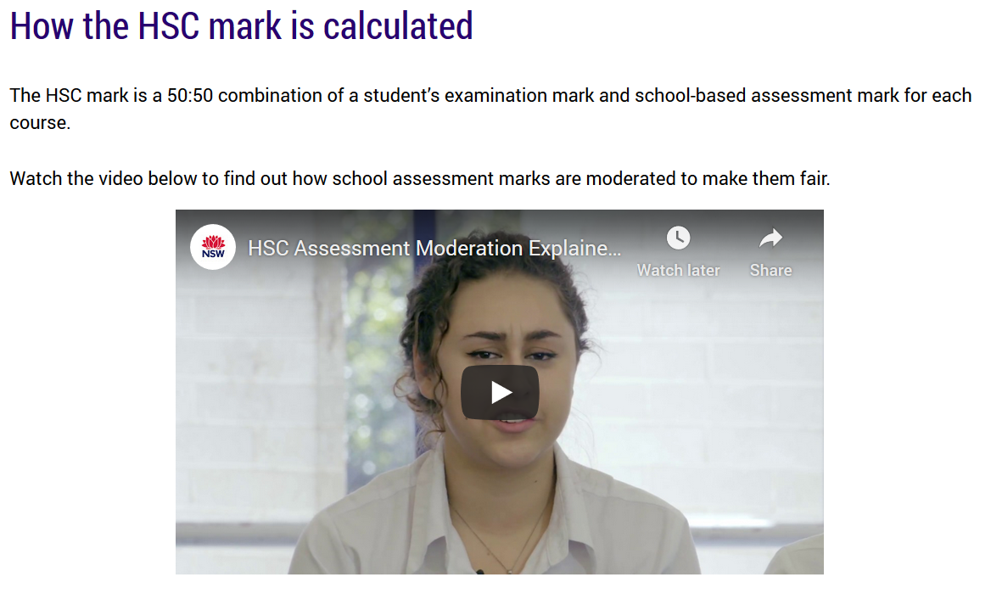
Excellent video explaining how the HSC mark is calculated.
https://www.educationstandards.nsw.edu.au/wps/portal/nesa/11-12/hsc/results-certificates/understanding-results
Notes:
Under the Year 11 – Year 12 tab > HSC > Understanding results > How the HSC mark is calculated
http://https://www.educationstandards.nsw.edu.au/wps/portal/nesa/11-12/hsc/results-certificates/understanding-results

Slide 29
Australian Tertiary Admission Rank

Slide 30
Australian Tertiary Admissions Rank
  The Australian Tertiary Admission Rank (ATAR):
  is for students wishing to gain a place at a university
  is a rank NOT a mark
  provides information about how a student performs overall in relation to other students
  is calculated by the University Admissions Centre (UAC)
Notes:
UAC will only consider Board Developed Courses in the calculation of the ATAR.
The ATAR provides the discrimination required by universities for the selection process.
The ATAR is calculated on the student’s best 10 units, which must include 2 units of English.
https://www.uac.edu.au/

Slide 31
More information
www.educationstandards.nsw.edu.au
www.uac.edu.au

Slide 32
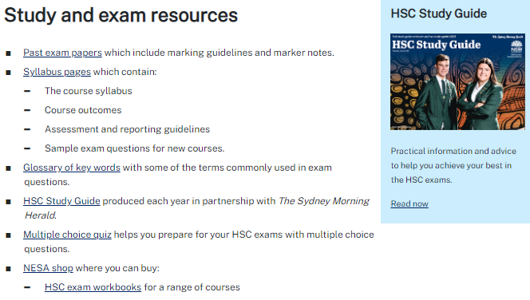
https://www.killarneyheightshscareers.com/
Notes:
The NESA website is also where students will find many good resources including the HSC Study Guide and HSC exam papers.
Go to https://www.educationstandards.nsw.edu.au/wps/portal/nesa/11-12/hsc/hsc-student-guide
NESA home > Year 11 – Year 12 > HSC > Student Guide

