Slide 1
Year 10 Parent Information Night

Slide 2
Acknowledgement
I acknowledge the Traditional Custodians of Country on which we meet today. I acknowledge the First Nations peoples’ connections to land, sea and community and pay my respect to their elders past and present and extend that respect to all First Nations people present with us today. Sovereignty was never ceded, it was and always will be Aboriginal land.

Slide 3
Ms Higgs
Year 10 Adviser
Notes:
Welcome to the Year Parent Information Night. I am really looking forward to supporting the cohort as year adviser supporting students. Having talked to some of the students so far this year, many of them have made a positive start to 2025.

Slide 4
Ms Rose
Deputy Principal
Yrs 7 & 11

Slide 5
Community building and strengthening connections
Creating meaningful parent involvement
Celebrating personal achievement and good behaviour
Establishing school norms and routines that build values
Creating rituals, celebrations and traditions that are fun for students and teachers
Encouraging innovation in the classroom
Professionally developing teachers
Explicitly teaching the importance of inclusion, kindness and compassion
Maintaining the physical environment of your school

Slide 6
Assemblies
To build a culture of our students working and learning together to build a sense of belonging.
We acknowledge the success of our students
We engage students with world issues such as NAIDOC, Harmony Day, IWD and Wear it Purple
We celebrate our school as a community

Slide 7
Student Leadership
Targeted student leadership program for SRC, Prefects and Captains to enhance transformational leadership skills. Student leaders have the opportunity to:
Advocate for change and shape school culture.
Develop charity and fundraising initiatives and positively impact the broader school community.
Develop skills in public speaking, inspiring others, event management, fundraising and community building.

Slide 8
Student Leadership
SRC and Prefect elections take place in term 2.
Students submit a written application and deliver a speech to their peers.
Positions are offered based on a combination or votes and the quality of the application and speech
Students interested in pursuing prefect and captaincy positions in years 11 and 12 will receive 5 additional points for each year served on the SRC.

Slide 9
Diversity and inclusion
We foster an inclusive and equitable school culture that fosters acceptance, appreciation and respect for all students, regardless of their socio-economic status, gender identity, sexuality, disability, body type, religion, race, culture, language background or accent.
We celebrate and embrace the diversity of the community.
We promote a harmonious and just school environment where everyone is valued.
We do not tolerate discrimination, prejudice, bullying, or vilification.

Slide 10
Positive Behaviour For Learning
PBL refers to the explicit teaching of classroom, playground and other whole school routines.
Routines foster a predictable and calm school environment and reduce uncertainty and anxiety.
Routines create the structure and stability required for a harmonious school community.
Routines minimise disruptions students and teachers to focus on the core business of teaching and learning.

Slide 11
Classroom routines
Trauma informed practice and to create a safe, predictable learning environment at KHHS. Provides consistency & predictability to support students.
Line up quietly in two straight lines facing the front with hats off.
Enter the room and move quietly and calmly to your assigned seat.
Get your equipment out and silently complete the DO NOW activity displayed on the board.
Pay attention as the teacher explains the lesson intentions, success criteria and lesson outline.
At the end of the lesson, pack up and wait silently and calmly for the teacher (not the bell) to dismiss you row by row.

Slide 12
mobile/Yondr pouches
What?
How?
A Yondr pouch allows students to bring their phone to school so you are able to access it on their journey to and from school.
When they get to school, their phone can be locked away so it does not get in the way of socialising with friends or focusing on your learning.
Place your phone inside the pouch before you walk through the front gate.
Use one of the locking stations located at the school gates to unlock your phone when you leave for the day.
Use the locking station at the front office if you are leaving early.
Notes:
To encourage you to develop ‘in person’ social skills and form positive relationships.
To encourage you to be physically active and participate in extra-curricular activities.
To help you concentrate and maintain the deep focus required to be successful learners.
To help you develop distress tolerance and the ability to self-regulate when things get tough.

Slide 13
bus stop
Unlock your Yondr pouches using the unlocking stations on the gate at the end of the pedestrian pathway.
Form an orderly line facing down the hill and wait until the teacher signals you to board the bus.
Opal Card out
The teacher will board the bus first, letting students in one by one.
Students who push will be sent to the back of the line.

Slide 14
Behaviour system
RESPECT (Instructions and environment)
Follow all instructions
Use school facilities and resources considerately
Be present and punctual
Wear school uniform
CONNECT (Relationships and community)
Foster positive, inclusive relationships
Interact with dignity and compassion
Celebrate difference and diversity
Collaborate positively
ASPIRE (Learning)
Strive for the highest standards in learning
Be ready and equipped for learning
Embrace challenge
Have a growth mindset

Slide 15
Rewarding positive behaviour
​ GOLD MEDAL ​ Awarded for receiving 500 Killa awards ​
​ SILVER MEDAL ​ Awarded for receiving 250 Killa awards ​
​ BRONZE MEDAL ​ Awarded for receiving 100 Killa awards ​
​ RIBBON ​ Awarded for receiving 50 Killa awards ​
​ CERTIFICATE ​ Awarded for receiving 20 Killa awards ​

Slide 16
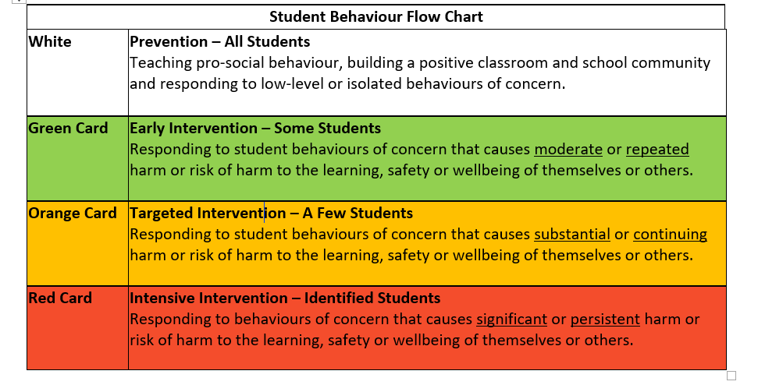
Behaviour system
Green Card
Orange Card
Red Card
Suspension Warning
Suspension

Slide 17
Restorative Practice
Restorative justice is an approach to discipline that focuses on repairing harm, restoring relationships, and promoting responsibility and accountability.
Restorative justice is a more effective and compassionate approach to discipline in schools than punishment.
It promotes healing, reconciliation, and responsibility, and helps students develop the skills they need to succeed in life.
Decreases the likelihood of future misbehaviour.
Improves relationships, fosters a positive school climate and helps students develop empathy, problem-solving skills, and a sense of responsibility.

Slide 18
Restorative Practises
Examples of restorative practices in schools include:
Restorative Circles
Conferencing
Mediation
Repairing harm activities
Can you explain what happened?
How did it happen?
What was the harm?
Who do you think was affected?
How were you affected?
How were they affected?
How do you feel about what happened?
What needs to happen to make things right?

Slide 19
Punishment
Restorative Justice
Often leads to negative outcomes, such as resentment, rebellion.
Does not address the root cause of the harm and does not promote healing for the individual or the community.
Fractures the students’ relationship with the school and increases feelings of alienation
Promotes healing and reconciliation between the individuals involved in a conflict.
Directly addresses the cause and impact of the harm caused through repair strategies and positive replacement behaviours.
Helps students understand the impact of their actions on others and encourages them to take steps to make things right.

Slide 20
Attendance
Supporting positive school attendance is a shared responsibility. Regular attendance is essential if students are to achieve their potential and increase their career and life options. Parents are legally responsible for the regular attendance of their children.
Parents are required to explain absences of their children from school promptly and within seven days by replying to the daily SMS, sending an email or using Sentral and providing a note/doctor’s certificate.
Partial absence – Where students are late for any reason they are required to report to the Administration Office, sign in and receive a late pass that is handed to the classroom teacher. Partial absences are legal absences and must be explained with a note of explanation from parents/carers. Parents will be informed if students are consistently late without explanation and the school may request a meeting.
Early Leavers – All early leavers must provide a note of explanation from parent/carer to the front office on the morning of the absence at the latest. Students will be issued with an early leaver slip and they must sign out of the front office when leaving the school.
Sport – Wednesday Sport is compulsory to meet mandatory hours of planned sport across the week for students in years 7-10. Partial Day absences due to medical appointments that unavoidably fall during this time need 24 hours notice via email to the office with evidence of the medical appointment eg screenshot of appointment booking. Unexplained absences will be treated as truancy with a letter to parents/carers and Friday lunchtime detention.

Slide 21
Ms Higgs
Year Adviser
Notes:
Welcome to the Year 10 Parent Information Night. I am really looking forward to supporting the cohort as year adviser supporting students. Having talked to some of the students so far this year, many of them have made a positive start to 2025.

Slide 22
Role of Year Advisor
The Year Advisor is the link between welfare resources in the school, wider community, the student and the family.
The Head Teacher Wellbeing will become involved for case management for families and students for significant welfare concerns.
Academic and class related issues should first be directed to the teacher, then you may escalate to the head teacher
Notes:
Please call or email me when you feel that the school needs to know/support your son/daughter with issues at home such as family illness or concerns you may have with your child’s progress.
The Welfare Coordinator is Ms Naomi Yorston (Mon-Thur) and Ms Michelle Freeman (Fri). The Welfare Coordinator will become involved in case management for families and students for significant welfare concerns

Slide 23
Role of the support staff
SASS staff – attendance, application of extended leave and administrative enquiries, payments over the phone
Online – parents can make payments, explain absences by calling the school number.
Counsellor & Learning Support staff – learning and welfare issues. Counsellors are on site each day, students can self-refer or parents can ask wellbeing team to organise. Can communicate with external support and support students with a variety of issues.
Student Support Officer - Candice works with individuals and small groups in wellbeing support.
Notes:
We have a number of support staff, available for students to talk to. There are professional psychologists on staff, someone available at school each day. They are available to students, but can also assist with parents and students. Parents are welcome to contact them.
Learning Support staff are available every day of the week in the library. Senior Students are encouraged to form small study groups to work together through the HSC.
Our Student Support Officer Eddy works with individuals and small groups for wellbeing support.
I will be communicating important messages to the cohort via google classroom. All students are encouraged to also download the app to stay up to date.

Slide 24
Communication with school
If you have an enquiry relating to your child please ring or email the Administration Office
Emails to the school will be passed on to relevant staff. Please detail the nature of the enquiry in the email so it can be easily directed.
Class and academic queries - classroom teacher or Head Teacher
Wellbeing concerns – Year Advisor (who will liaise with Head Teacher Wellbeing where necessary)
Learning Support concerns – Learning and Support Teacher
Careers, TAFE and future pathways queries – Careers Advisor
Notes:
If you have an enquiry relating to your child please ring or email the front office. I will be the contact for minor wellbeing concerns whereas the DP will deal with more significant wellbeing issues. Classroom teachers or faculty head teachers are the point of contact for isolated academic queries.

Slide 25
Our Welfare focus for the year
Goal 1: Maintaining respectful relationships, conflict resolution and academic resilience
Goal 2: Resilience, Respectful Relationships, Work Experience and Academic Goals
TIME | Activity | Approx. Cost
Term 1 | Study Sensei (wk 4) – organisation and study skills workshop | $12
Term 3 | Relationships Australia (TBC) - small group, whole year program. Focusing on respectful relationships, conflict resolution, and setting boundaries within friendships | N/A
Term 4 | Work Experience (wk 6) – Students will participate in work placement | N/A
Notes:
These welfare activities have been planned to meet the perceived needs of students in Year 10 and to better support the school community. Data analysed from the 2024 TTFM surveys and student feedback has guided this planning process.
These programs aim to develop the wellbeing of students by providing strategies in dealing with a range of issues for adolescents. The focus aims have been developed with Year 10 being an important year in setting up good habits for the Senior School.
Aspiration has been chosen as a focus as it directly relates to students aiming for their personal best and developing achievable goals for themselves. Organisation is particularly important prior to their senior studies and the Study Sensei workshop will help students to develop good patterns in their workload and study.

Slide 26
Small Group wellbeing
Students contact their Year Adviser to join:
Rise
Thrive
RAISE
SSO-run wellbeing programs eg Skills for School; Gardening/school projects; Empower & Energize
These programs run throughout the year, contact us when you see them in the newsletter

Slide 27
Extra-curricular opportunities
The more students get involved in school programs,
the more they will get out of their education.
Duke of Edinburgh
SRC
Prefects
Science Club
Coding Club
Chess Club
Gifted and Talented sports
Warhammer Alliance
Breakfast Club
Stage Crew
Music Ensembles: Big Band, Concert Band, Guitar Ensemble, Chamber Ensemble, Rock bands, Vocal Ensemble
Knock-out sport competitions: AFL, Baseball, Basketball, Cricket, Football, Netball, Touch, Tennis, Volleyball

Slide 28
MILO Club My Individual Learning opportunity
Monday and Thursday afternoon
in the library 3.10-5pm
Supervised by a Maths or English teacher
An excellent way to get help with assignments

Slide 29
Ms Walters
Deputy Principal
Years 8 & 10

Slide 30
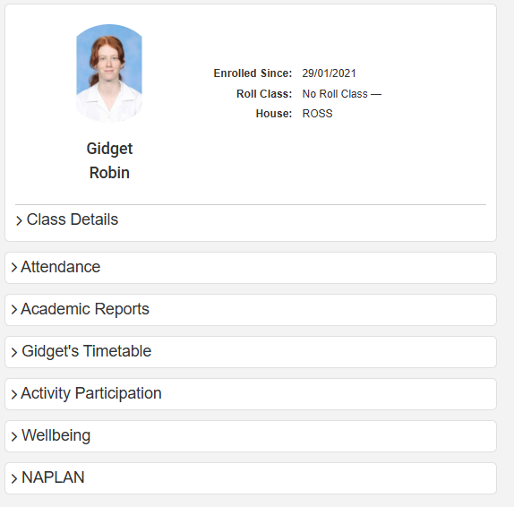
Parent Portal -Website
Notes:
From the Parent Portal, you can see the school calendar, with all the events for your child's year group and whole school activities. You can also see a summary of your child's attendance and explain absences and update contact details online

Slide 31
Parent Portal - App
Download Sentral Parent App
Select school
Notes:
Once you have clicked on the photo of your child, you will be able to see the Daily Notices (our main communication to students throughout the day), your child's timetable and their teachers, awards they receive, previous years reports, NAPLAN data, etc. This is a very useful resource for parents to see the progress of their child.

Slide 32
Laptops
Used as a tool to enhance learning
Lockers are available
Buy a hard case
Charge every night
Short term loans are available

Slide 33
Assessment – Purpose
monitor student progress through an assessment
provide ongoing feedback
identify their strengths and weaknesses
target areas that need further work.
Formal homework is not always set; students may be required to submit components of their assignment for feedback during the process of completing an assessment.

Slide 34
Senior Course Requirements and N-Warnings
Students must successfully complete 12 units in order to qualify to move on to the HSC in year 12.
Students must submit all assessment tasks on time.
Students must make a serious attempt at all assessments and examinations.

Slide 35
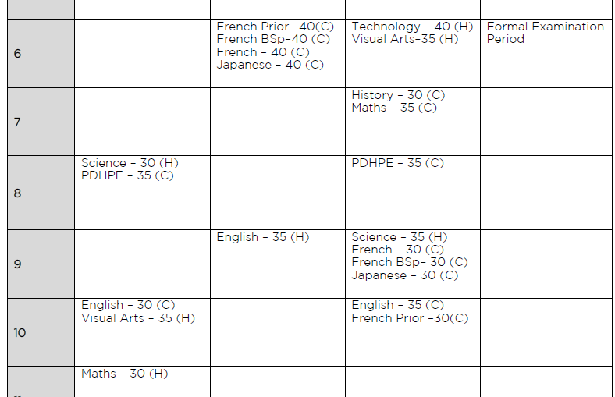
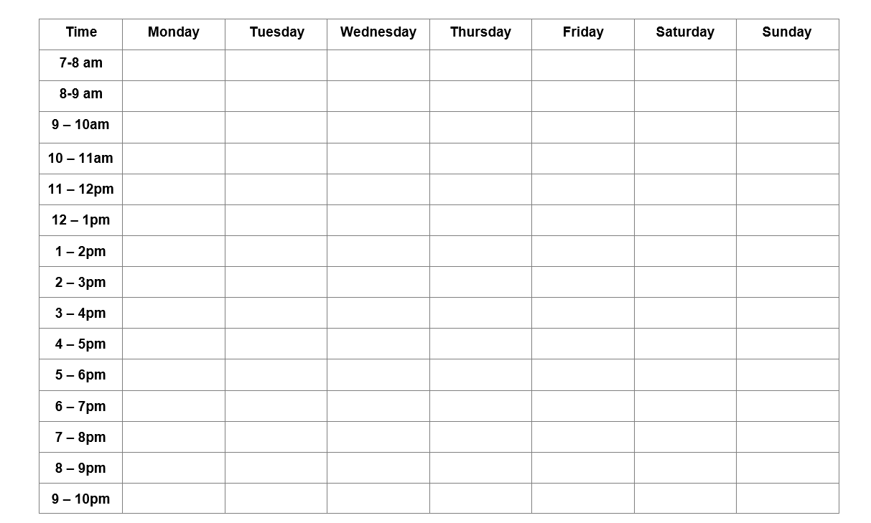
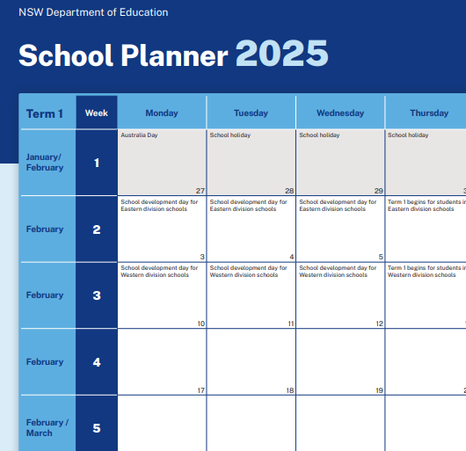
Organisation session
Students received –
Assessment Handbook
Term Planner
Blank Study Template

Slide 36
Feedback
Feedback can take many forms and is regularly provided to students. It can take the following forms:
Written feedback (Google docs/handwritten)
Verbal feedback in class
Student samples in class
Group feedback slides
Peer feedback in class

Slide 37
Study Expectations
Practice Makes Progress - Aim to be a little bit better today than yesterday.
Consistency – Do a little bit very often.

Slide 38
Year 8 into Year 9 Subject Selection
At the end of Term 2, we discuss subjects for Year 9
Core Subjects:
English, Maths, Science, Geography, History, PDHPE
Students choose three Electives from faculties:
CAPA, Languages, TAS, PDHPE, HSIE, Science
Students are encouraged to choose subjects that they are interested in – not necessarily what will set a path for university.

Slide 39
Study routines
School is a marathon, not a sprint. There is a lot to achieve in the year – start early
Visual reminders for tasks: use a wall planner
Quiet place for regular study
Develop regular study habits and a study timetable
Regular daily revision is more effective than cramming before an exam
Time management is key!
Seek feedback
Notes:
Students should ensure that they are preparing adequately for assessment tasks by using visual reminders, regularly consolidating their notes and learning as part of their revision and refer to their syllabus.
To be organised for assessments and to form good senior study habits students should organise themselves.
A calendar of assessments and study timetable should be developed and be easily accessible so they can see at a glance which assessments are due and at what times.
Students are encouraged to begin assessments early and seek clarification if they are unsure.
They should read marking criteria carefully and ask questions or seek advice from their teachers and mentors.

Slide 40
Feedback and assessment
Feedback can take many forms and is regularly provided to students. It can take the following forms:
Written feedback (Google docs/handwritten)
Verbal feedback in class
Student samples in class
Group feedback slides
Peer feedback in class

Slide 41
Assessment – Policy
Assessment tasks are to be submitted on time
If a student is away the day a task is due, they must provide an explanation in writing from the parent.
The letter and task are to be submitted on the first day back at school.
If no explanation is provided, then the student will receive a mark of zero. However, the task must still be completed to complete the course.
Students and parents will be notified in writing when a mark of zero is awarded.
Notes:
It is an expectation that students submit all assessment tasks on time, otherwise a mark of zero may be awarded if there is no reasonable explanation.
This is for the purpose of equity for student, and also quality feedback from teachers.
This policy aligns with the NESA policies for Years 10-12. We uphold this policy for years 7-9, as we believe they are better off making mistakes earlier and learning from them before reaching year 10.

Slide 42
Senior Course Requirements and N-Warnings
Affects students in years 10 -12
Students must submit all assessment tasks on time.
Students must make a serious attempt at all assessments and examinations.
If 2 warning letters are not redeemed a student may not pass that subject
Students have 2 weeks to redeem a warning

Slide 43
Year 10 into Year 11 Subject Selection
At the end of Term 2, we discuss subjects for Year 11
Students are encouraged to choose subjects that they are interested in – not necessarily what will set a path for university.

Slide 44
Year 10 Work experience
All students in Year 10 are required to undertake Work Experience in Term 4. It is an opportunity for students to find out about the world of work.
The main aim of Work Experience is for students to develop the confidence to locate suitable work placements, to submit a CV/resume and make an application in person, by email or phone.

Slide 45
Questions?
This powerpoint will be uploaded to the KHHS school website under ‘Year Information’.
Notes:
All of the information that we covered tonight and more is available on our school website

